Slide 1


SMART INDIA HACKATHON 2026
SMART INDIA HACKATHON
2026
TITLE PAGE
Problem Statement Title –Urban Flood Nowcasting System (Drainage and Rainfall Coupling).
Theme –Disaster Management
PS Category – Software
Team Name – The OutThinkers
Problem Statement ID – 26085

Slide 2

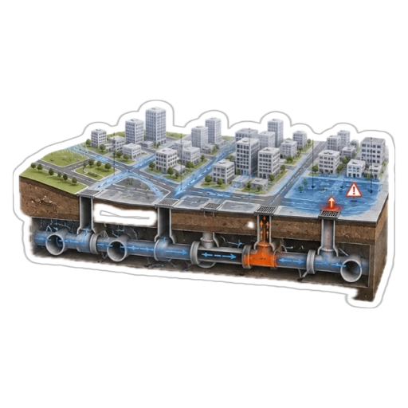
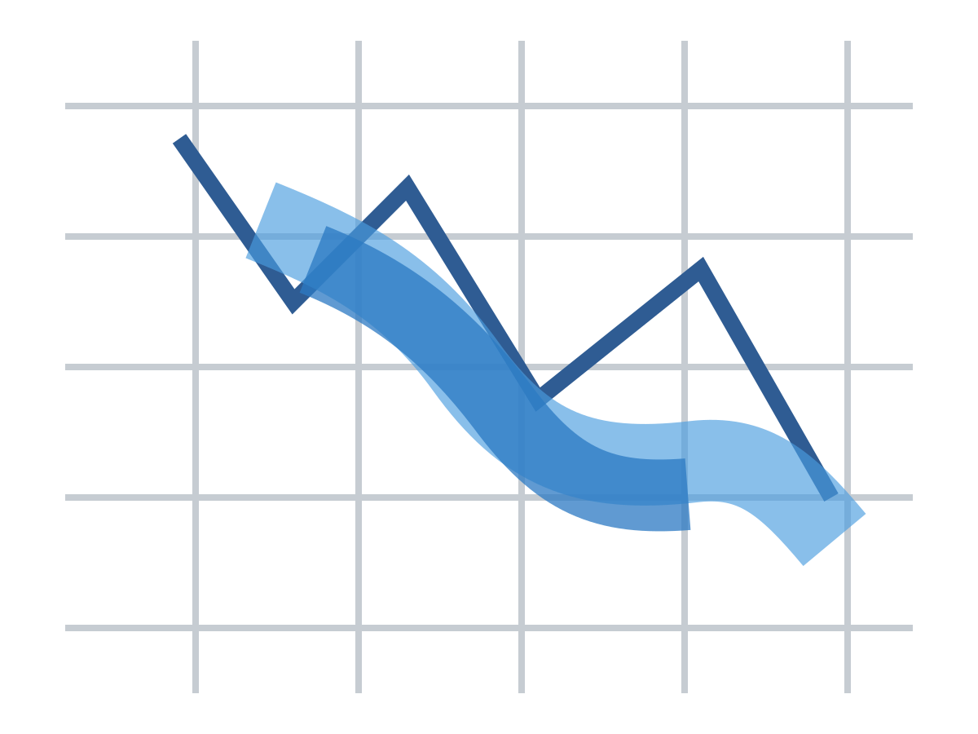

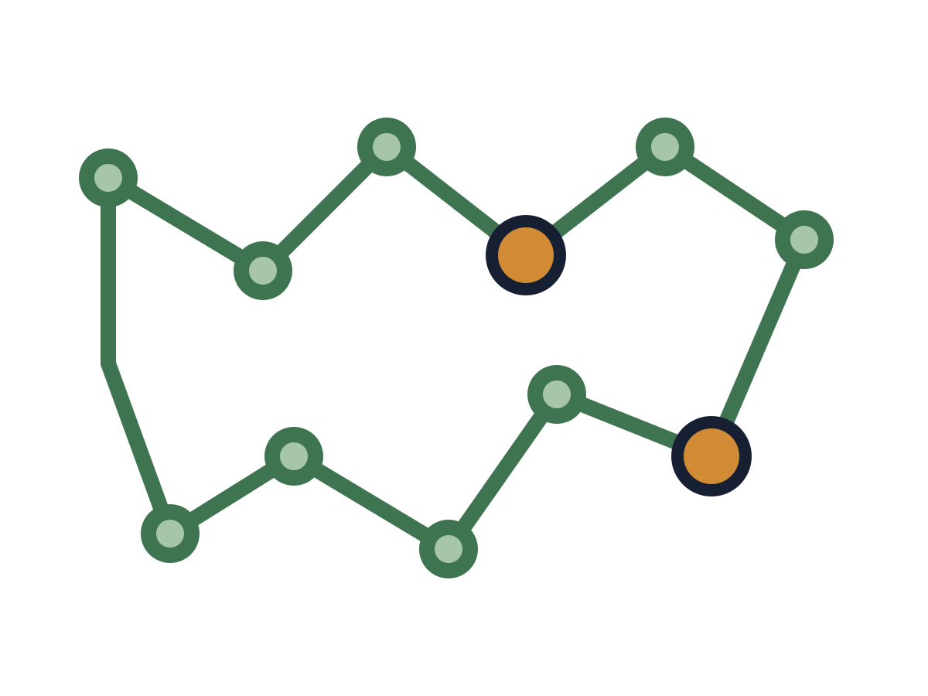
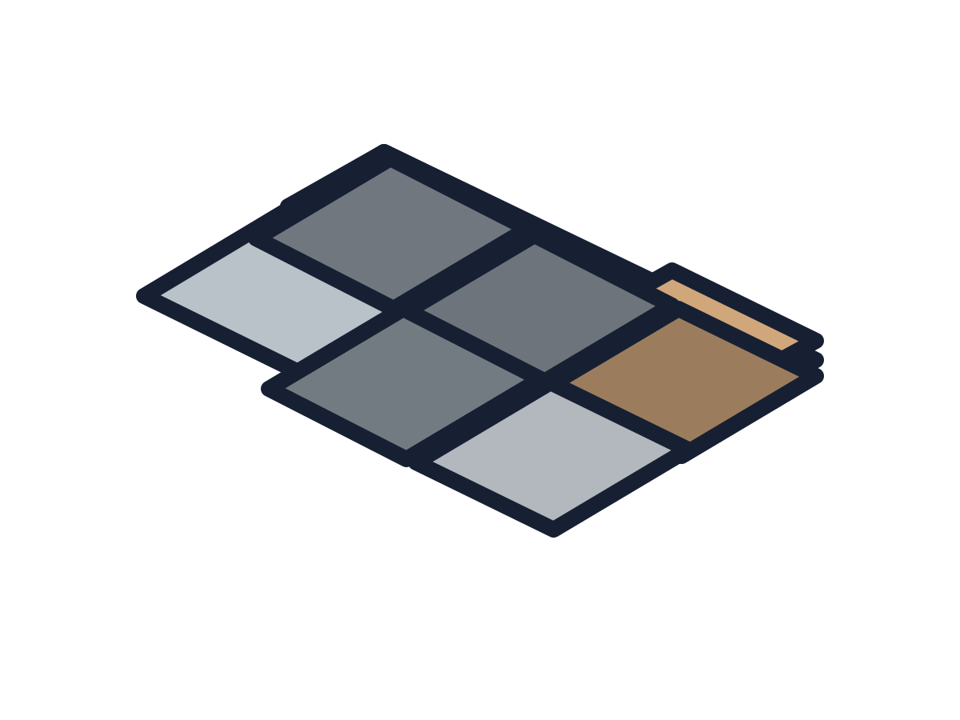








THE
OutTHINKERS
IDEA & PROPOSED SOLUTIONS
SMART INDIA HACKATHON
2026
Physics-Informed Urban Flood Nowcasting through Rainfall–Terrain–Drainage Coupling
From rainfall forecasting → coupled urban inundation nowcasting
THE CORE CHALLENGE
1)RAINFALL NOWCAST
High-resolution spatial & temporal rainfall input.
2)TERRAIN & SURFACE
DEM, land use & roughness define flow paths.
3)2D SURFACE RUNOFF
Runoff generation and overland flow routing.
4)1D DRAINAGE NETWORK
Nodes, inlets & pipes with capacity and connectivity.
5)HYDRAULIC RESPONSE
Capacity limitation → surcharge, backflow, overflow.
WHAT THE SYSTEM DELIVERS
Rainfall ≠ Flood Location
Rainfall forecasts tell us how much rain may fall, not where streets will flood.
6)STREET-LEVEL INUNDATION
Water depth and flood extent on streets.
A — FLOOD INTELLIGENCE
-Street-level water depth
-Flood extent & accumulation
-Time-evolving flood risk
Micro-topography Local elevation and depressions control water accumulation.
B — DRAINAGE INTELLIGENCE
-Node surcharge
-Capacity utilisation
-Pipe stress
Surface characteristics Impervious surfaces increase runoff generation.
C — DECISION SUPPORT
-Flood-aware route planning
-Risk-aware alerts
-Citizen issue reporting
Drainage hydraulics Network capacity and connectivity regulate
Conveyance.
Blockage / surcharge Restricted flow causes surcharge, backflow and surface overflow.
LEAD TIME
0 – 3 HOURS
Spatio-temporal flood nowcast at street/intersection level.
FROM PREDICTION TO ACTION
PREDICT
PRIORITISE
ALERT
ACT

Slide 3





















THE
OutTHINKERS
TECHNICAL APPROACH
SMART INDIA HACKATHON
2026
INPUT
Technology Stack
Rainfall/Radar Nowcast
High-res
Dem
Drainage
Network
Roads/
Land- use
Citizen
Reports
Cloud
(AWS/GCP)
Database
(SQL , PostGIS)
HYDRAULIC
ENGINE
Rainfall Runoff
2D surface Flow
Drainage Capacity
Stream processing
Blockage
Backflow
Surface-drainage coupling
AI/ML
(Python , pytorch)
GIS & Mapping
(Leaflet / GeoServer)
OUTPUT
Water depth
(cm)
Flooded street
Critical Drainage nodes
0-3h
Forecast
Flood -aware
Routing
Visualization

